Slide 1
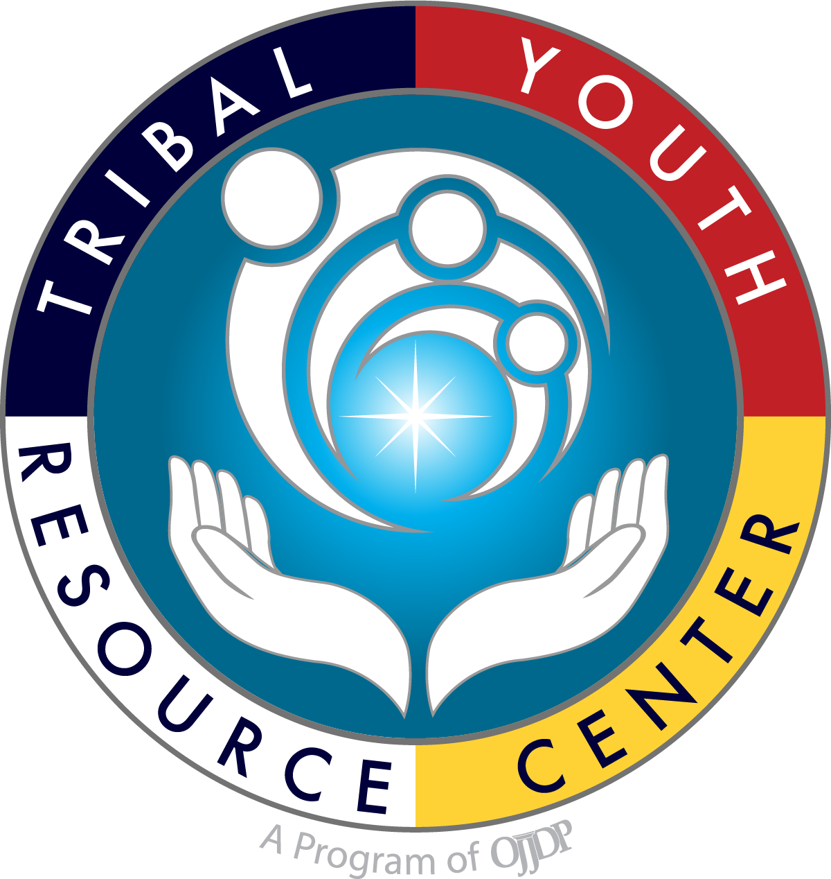
Cultural Considerations and Family/Parent Engagement in the Juvenile Healing to Wellness Court
Juvenile Healing to Wellness Court Development and Planning
Developed By: JD Tribal Youth Resource Center Strategic Planning Resource Materials
Updated Spring 2021 Family Engagement Materials: Kristina Pacheco, LADC and Anna Clough, JD
Notes:
Developing a project vision and mission statement

Slide 2
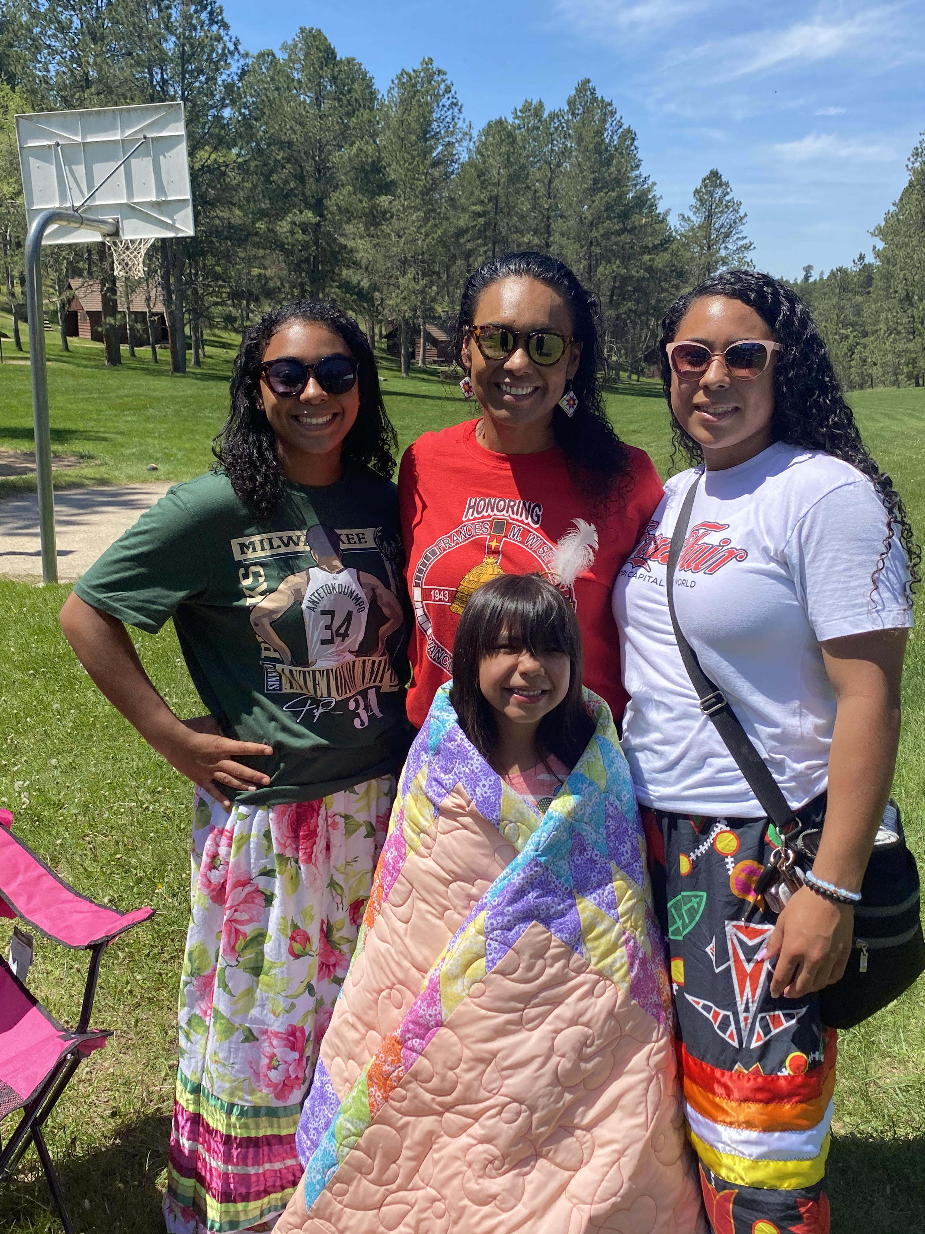
Opening in a Good Way

Slide 3
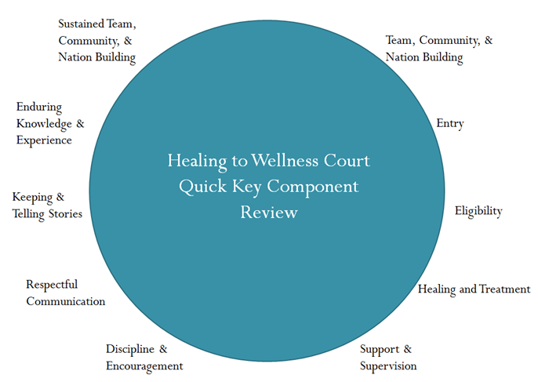
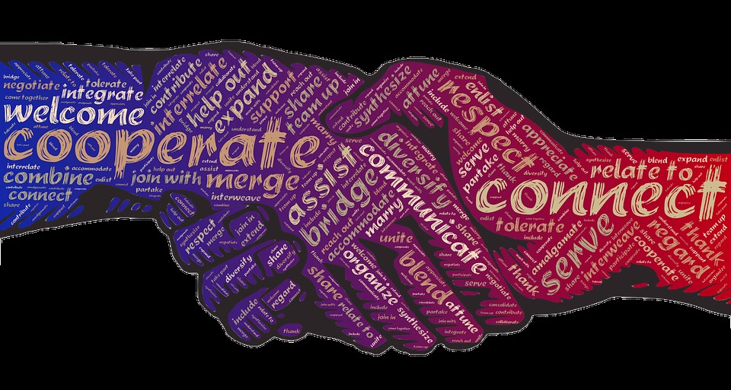
Cultural Connections
What makes the JHWC different than a conventional treatment court?
Notes:
A Key Component to Healing to Wellness Courts- See Wellness Court Key Component 10- Team Interaction- The development and maintenance of ongoing commitments, communication, coordination, and cooperation among Tribal Healing to Wellness Court team members, service providers and payers, the community and relevant organizations, including the use of formal written procedures and agreements, are critical for Wellness Court Success.
Effective communication is necessary and vital to support youth participants and integral to a “team-based” approach.
Wellness Court, by design, sheds the formal rules of evidence and other communication protective measures present in the adversarial system (with consideration to participant confidentiality). (See Tribal Healing to Wellness Courts: Case Management, at 24)

Slide 4
Youth-Focused Treatment and Engagement
How will your court implement youth-focused cultural engagement?

Slide 5
Wellness Court that is Youth-Focused
Non-adversarial approach.
Focus on healing and positive behavior change.
Holistic relationships and increased community connectedness.
Promotion of accountability, individual and community safety.
Wellness is not a destination, but a journey.

Slide 6
Culture as a Key Component
Tribal Wellness Courts- The Key Components:
Key Component #4- Treatment and Rehabilitation- Tribal healing to wellness court provides access to holistic structured and phased alcohol and drug abuse treatment and rehabilitation services that incorporate culture and tradition.

Slide 7
Wellness Court Concepts:
Consistent with traditional Native justice concepts and methods.
Focus on the root cause of underlying addictive or abusive behavior that results in court involvement- rather than the act alone.
Traditional methods focus on healing and often involve family, extended family, and community in the healing process.

Slide 8
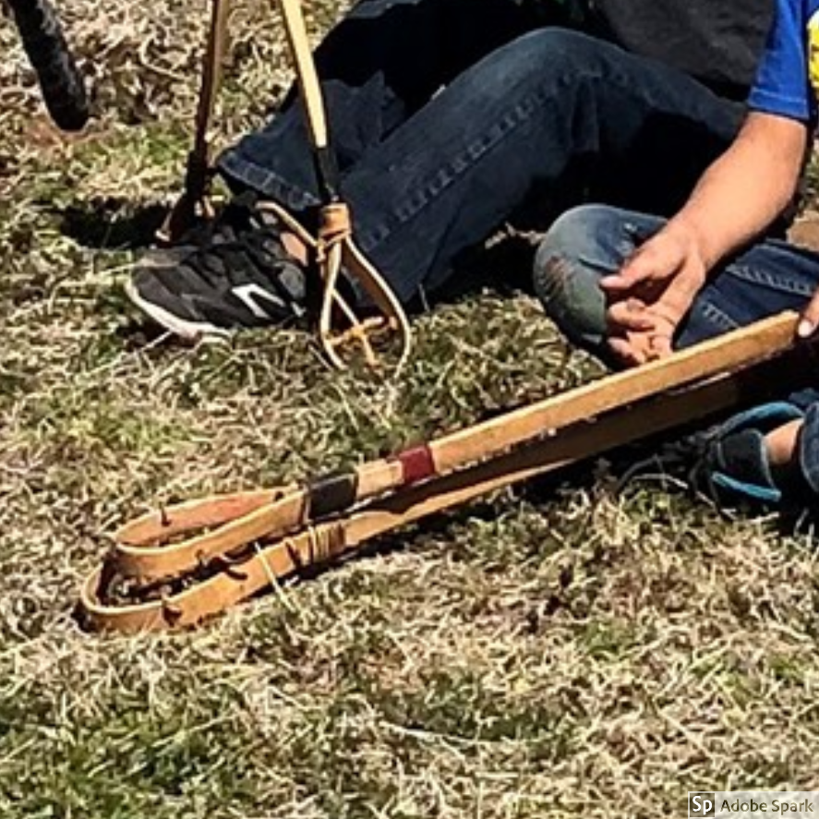
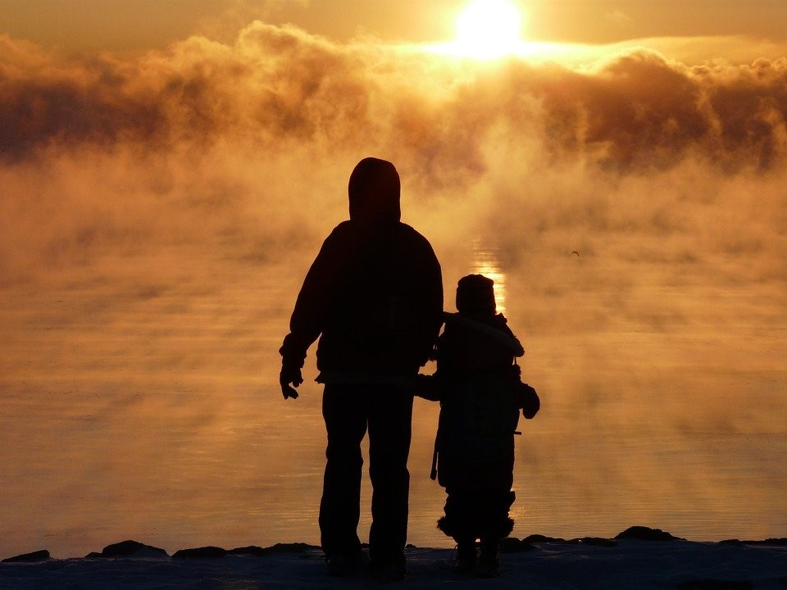
Culture as a Key Component
A wide range of cultural, traditional, customary, and/or community values, practices and activities incorporated within the “phased plan.”
Activities may be diagnostic, healing, cleansing, reparative, restorative, peacemaking, mediation, and a variety of other culturally grounded participatory activities to support connection and therapeutic community response.¹
Activities may engage spiritual leaders, elders, educators, and others to support wellness court participants.
1. Tribal Healing to Wellness Courts, The Key Components (2nd Ed. 2014) at 32

Slide 9
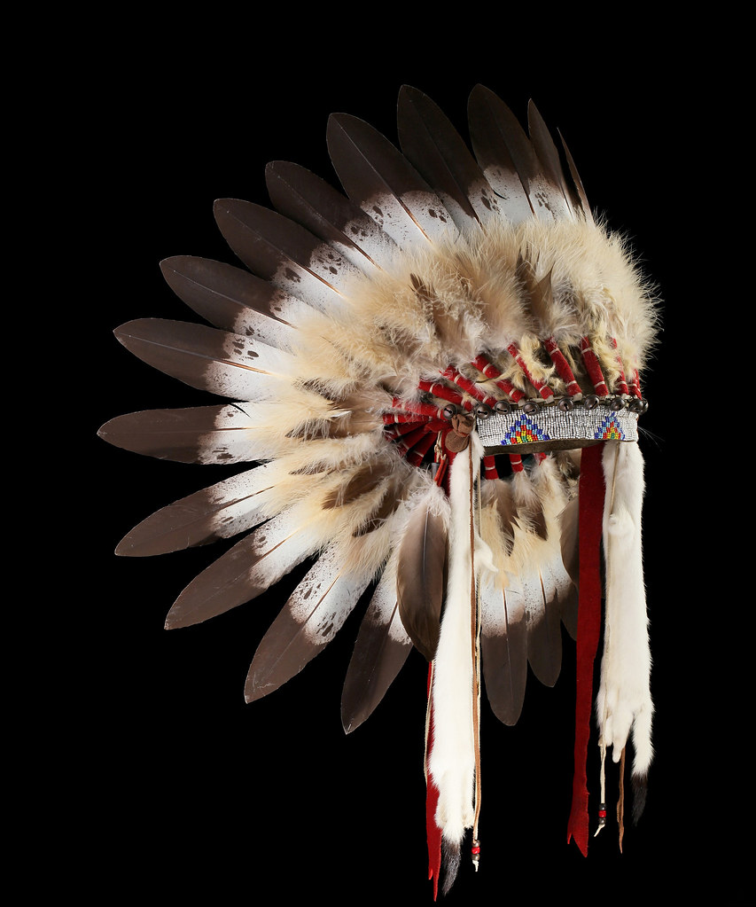
Supporting the “Whole” Person
School/Education/ Employment
Family Bonds
Peers/Friendships
Culture/Spirit
Treatment (Levels of Intervention)
Health (Physical & Mental)
JHWC teams provide avenues for healing and accountability in many areas of the youth’s life.
This Photo by Unknown Author is licensed under CC BY-NC-ND

Slide 10
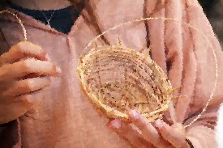
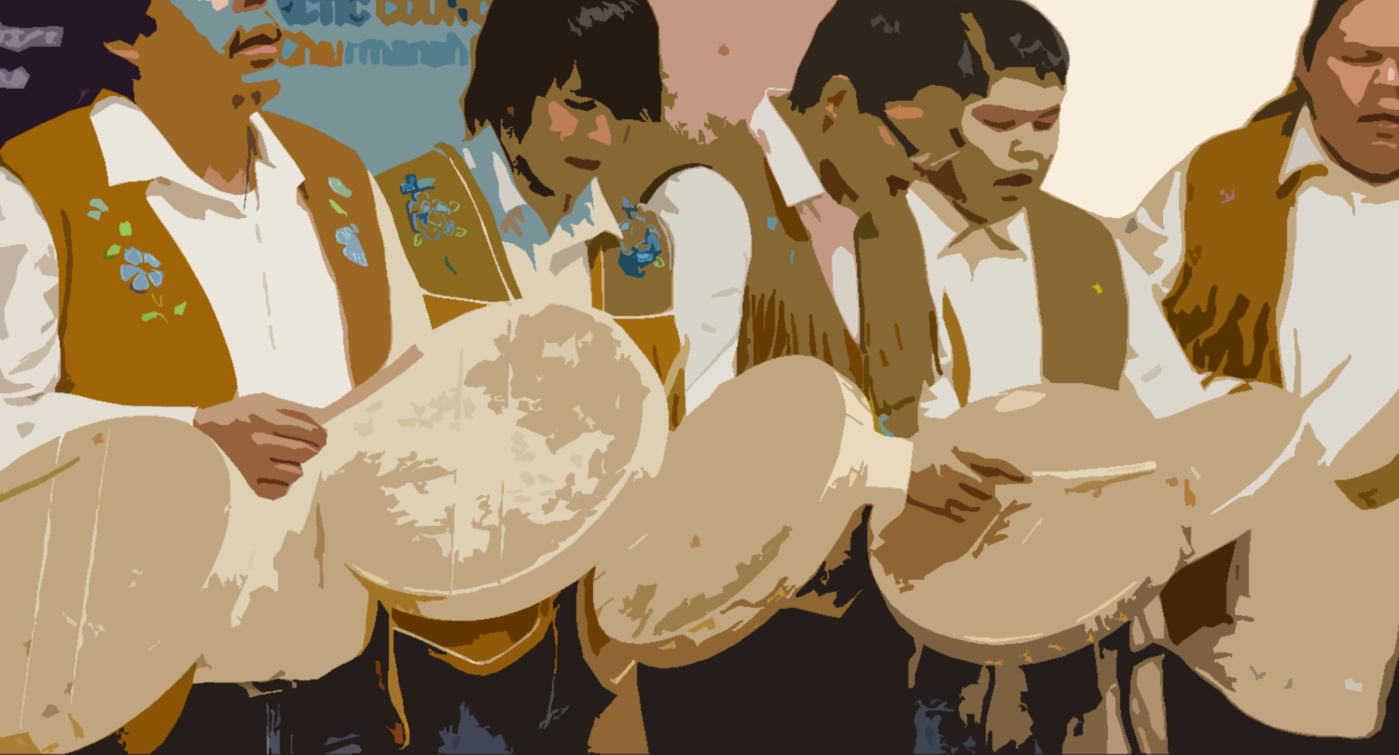
Integration of Cultural Ways in the Juvenile Wellness Court
Ceremony and Ritual
Tribal Arts
Ancestral Kinship
Traditional Lifeways

Slide 11
Cultural Modules and Youth Development
How Do We Measure Cultural Connectedness?
Cultural Connectedness Scale- developed in Canada by First Nations/Indigenous persons for First Nations/Indigenous communities.
29 items with three sub-scales:
Identity, traditions and spirituality.
Indigenous Quantitative Methodological Framework, community and strengths-based approaches are the core of the framework.¹
Culture is an important determinant of health for Indigenous peoples.²
King et al., Culture is Prevention Project: Adapting the Cultural Connectedness Scale for Multi-Tribal Communities, American Indian and Alaska Native Mental Health Research, Centers for American Indian and Alaska Native Health, Colorado School of Public Health at 110-11
Id at 119

Slide 12
Cultural Modules and Youth Development
Other methods to measure
Awareness of Connectedness Scale
18 item quantitative assessment.
Utility in the study of culture-specific protective factors and as an outcomes measure for behavioral health programs with Native American Youth.
Adaptation is Key.
Mohatt et al., Assessment of Awareness of Connectedness as a Culturally-based Protective Factor for Alaska Native Youth, Culture Divers Ethnic Minor Psychol, 2012.

Slide 13
Traditional Tribal Family Engagement
Family engagement is natural within Tribal communities through culturally motivated events, customs, or practices.¹
Traditionally, families have been essential to the survival, well-being, and livelihood of tribal communities and have served many roles in the community such as:²
Decision-makers
Protectors
Teachers
Hunters
Gatherers
Keepers of customary practices
Caregivers of elders and children
National Indian Child Welfare Association, “Traditional Family Engagement,” Tribal Best Practices A Toolkit with Best Practices, Research, and Resources.
Ibid.

Slide 14
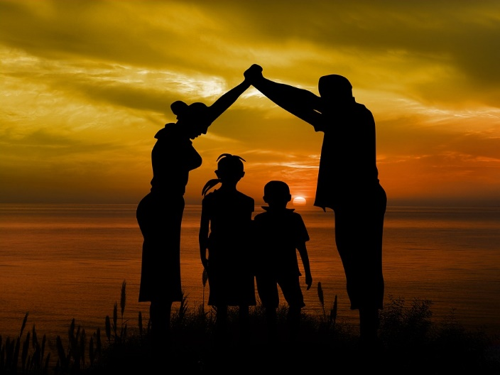
Family and caregiver engagement is critical to the success of the JHWC.
Consideration is given to address critical needs and celebrate existing strengths/success.
Adherence to applicable laws and policy that entail parental consent.
Engagement with families to ensure youth can access required/needed services.

Slide 15
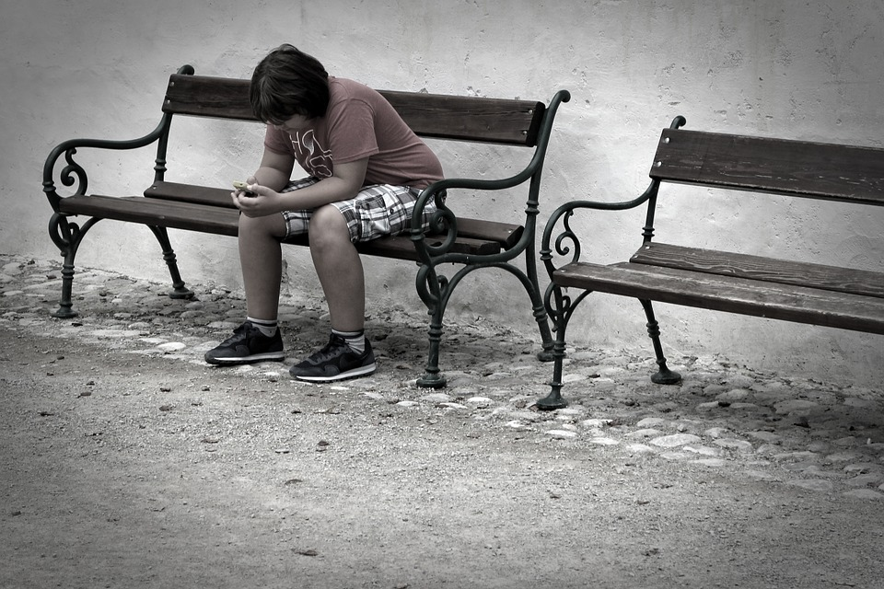
Wellness Court teams work together to address individual and known community risk factors.
AI/AN families and youth may face challenges:
Educational Attainment, Gaps in Achievement, Attendance, and Post-Secondary Readiness.¹
Poverty
Homelessness²
Lack of critical resources
Lack of employment opportunities in the local area
Health Disparities
Englert et al., “Guide to Conducting a Needs Assessment for American Indian Students,” Institute of Education Sciences, 2020 at 1.
Ernst et al, Environmental Scan Summary Report, Native American Center for Excellence, 2008 at 10.

Slide 16
Parent and Family Involvement with Youth in the Tribal Juvenile Justice System, (McKay et al., 2014)-
Limited by practical constraints- competing commitments
Scarce resources
Mistrust
Lack of effective communication between parents and those who teach and serve their children
Perceptions of parenting deficiencies by youth-serving teachers/staff
Parent perceptions of mainstream services that lack cultural relevance
Feelings of being unwelcome, blamed, or discomfort with the juvenile justice system
McKay et al., “Parent and Family Involvement with Youth in the Tribal Juvenile Justice System: Perspectives from OJJDP’s Tribal Green Reentry Initiative,” RTI International, 2014

Slide 17
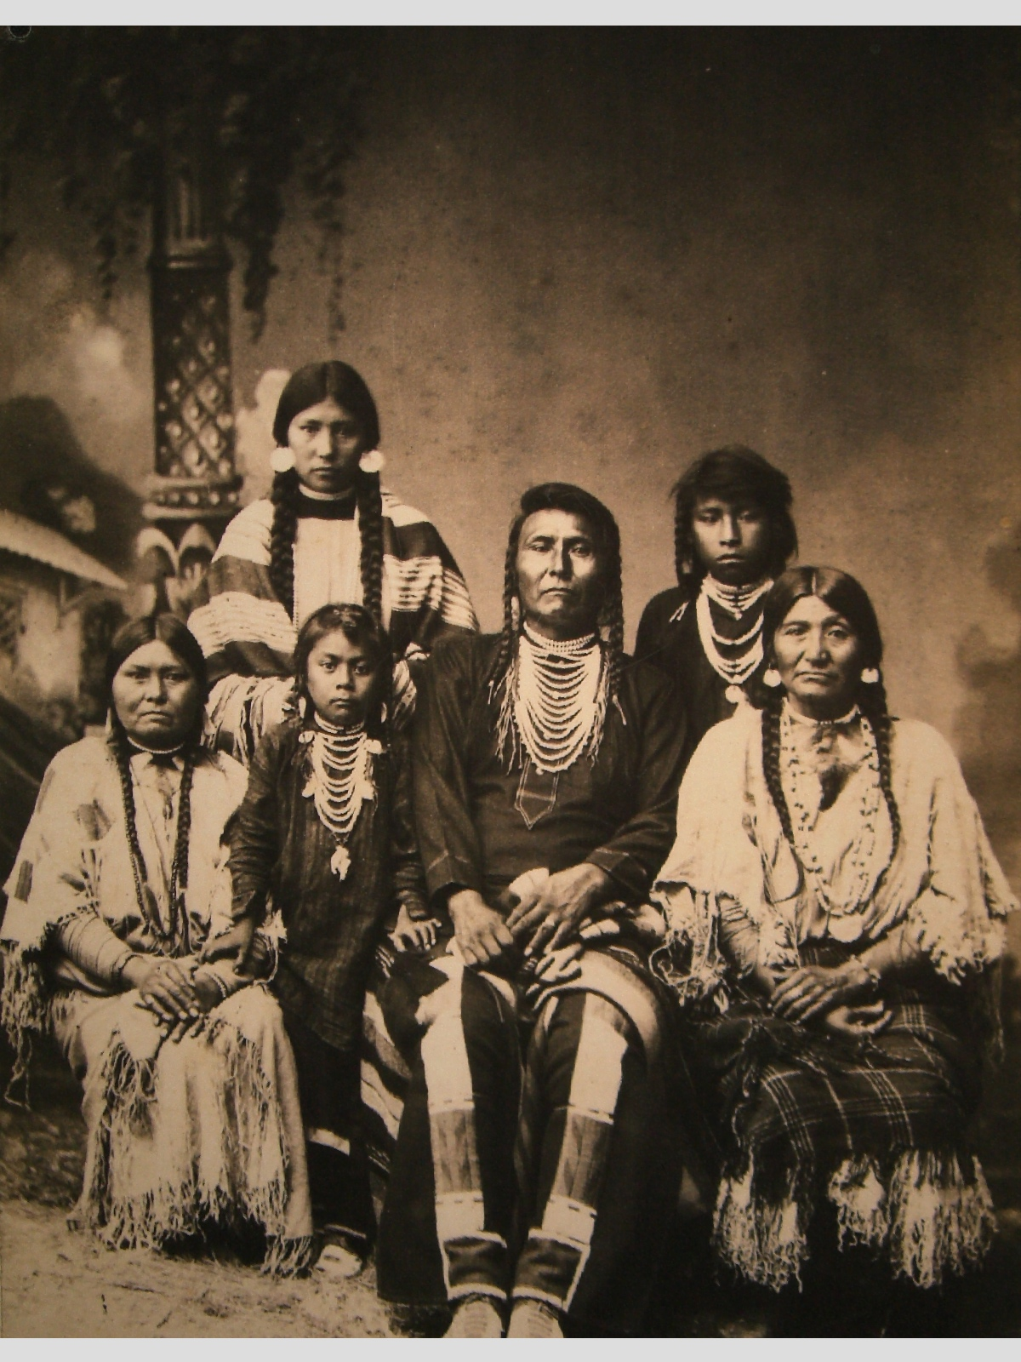
Suggested findings in Juvenile Treatment.¹
Family engagement counteracts barriers and risk factors.
Increased caregiver attendance lessens youth absence from school, missed treatment sessions, lowers application of sanctions.
Family engagement + Contingency Management more successful than Contingency Management alone.
Harris et al., “Engage, Involve, Empower, Family Engagement in Juvenile Drug Treatment Courts,” NCJFCJ National Center for Mental Health and Juvenile Justice,

Slide 18
Inclusion of not only the biological, but extended family and recognized community members.¹
Tribal communities often have:
Stronger extended family networks/prevalent extended family.
Intergenerational living arrangements.
Aunts, uncles, cousins and siblings have all been shown to influence Tribal youth substance abuse or abstinence from substance abuse.²
1. McKay et al., “Parent and Family Involvement with Youth in the Tribal Juvenile Justice System: Perspectives from OJJDP’s Tribal Green Reentry Initiative,” RTI International, 2014
2. Ibid.

Slide 19
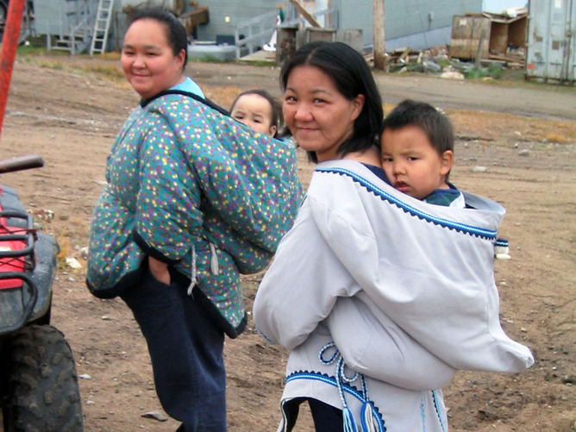
Generally,
Improved communication between youth-serving staff (including program staff and justice system employees) and parents or guardians.
Whole family approach to programming that engages parents, siblings, grandparents, and extended family members.
1. McKay et al., “Parent and Family Involvement with Youth in the Tribal Juvenile Justice System: Perspectives from OJJDP’s Tribal Green Reentry Initiative,” RTI International, 2014
2. Ibid.

Slide 20
Wellness Court- Inclusion and Communication
Orientation that includes parents and/or guardians.
Inclusion in case planning/management. Including provision of resources or support such as transportation or provision of communication devices.
Consideration for family schedules and prior commitments.
Identification and referral to helpful services and resources.
Opportunities to engage with JHWC Team and share about challenges and successes throughout the case process.
Incentives that include the whole family.
(Gift cards, movie nights, praise/acknowledgment).

Slide 21
Cultural customs among AI/AN groups vary significantly even within a single community. Some reservations are home to multiple bands or tribes.¹
Preserving spirituality and a sense of unity is important to youth well-being. The right to one’s own culture and religion is reported to be a youth-welling indicator.²
Example AI/AN Youth Protective Factors³
Personal Wellness
Positive Self-Image
Self-efficacy
Familial and Non-Familial Connectedness
Positive Opportunities
Positive Social Norms
Cultural Connectedness
Youth.Gov, “AI/AN Youth- Cultural Considerations,” Accessed March 2021
Ibid.
SAMHSA, “Culture is Prevention,” 2018

Slide 22
Culture as a key component
“By strengthening individuals, healing to wellness courts (in turn) empower families, which are fundamental to indigenous cosmology and centerpieces of Native societies.” ¹
“Wellness Courts are institutions that work to identify and promote like beneficial connections for their participants and encourage long-term connectivity to sources of support.” ²
Flies-Away and Garrow, Healing to Wellness Courts: Therapeutic Jurisprudence+” 2013 Mich.St.L.Rev.403, https://ndcrc.org/wp-content/uploads/2020/08/Healing_to_Wellness_Courts_Therapeutic_Jurisprudence.pdf at 408.
Id. At 425.

Slide 23
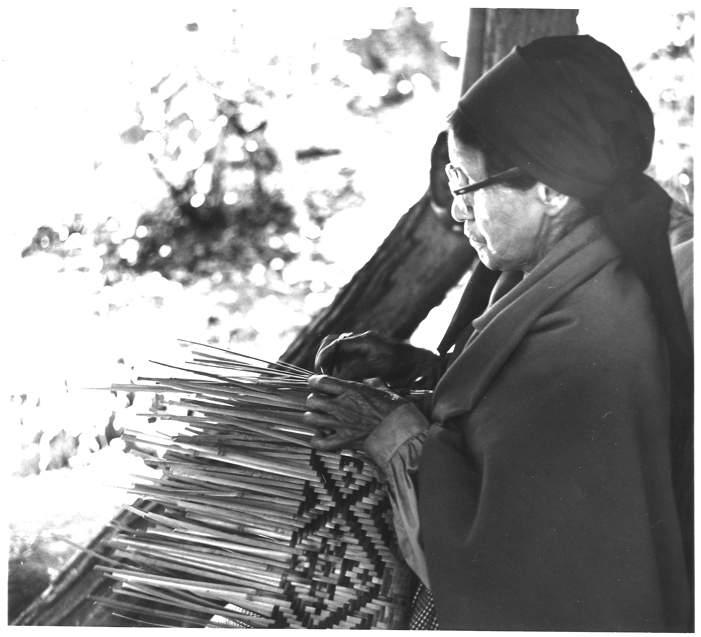
Stop and Reflect
What steps are needed to support youth as they develop connections within the local community?
What steps will the team take to support whole family involvement and coordinated communication with parents and caregivers?
What resources are needed to implement either of these components within the JHWC?

Slide 24
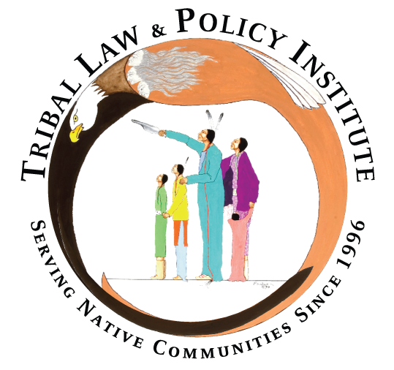
Thank you for viewing the presentation.
Need more assistance?
Just let us know.
The Tribal Youth Resource Center is led by the Tribal Law and Policy Institute in partnership with the National Native Children’s Trauma Center
You can contact us by reaching out to your assigned Training and Technical Assistance Specialist or you can email us at TribalYouth@TLPI.org
When you email please note that you need assistance with strategic planning. We will connect you with your TTA specialist or any needed resources.
This project was supported by Grant #2018-MU-MU-K001 awarded by the Office of Juvenile Justice and Delinquency Prevention, Office of Justice Programs, U.S. Department of Justice. The opinions, findings, and conclusions or recommendations expressed in this publication/program/exhibition are those of the author(s) and do not necessarily reflect those of the Department of Justice.

